Slide 1
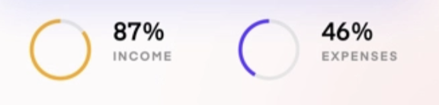





Home page
Edit page
Hi Susana
Dashboard
EDIT
Your Categories
This month
Category 1
Category 2
Slide bar
Your Transactions
This year
icon
Name
amount
Graph with this yearly trends
icon
Name
amount

Slide 2
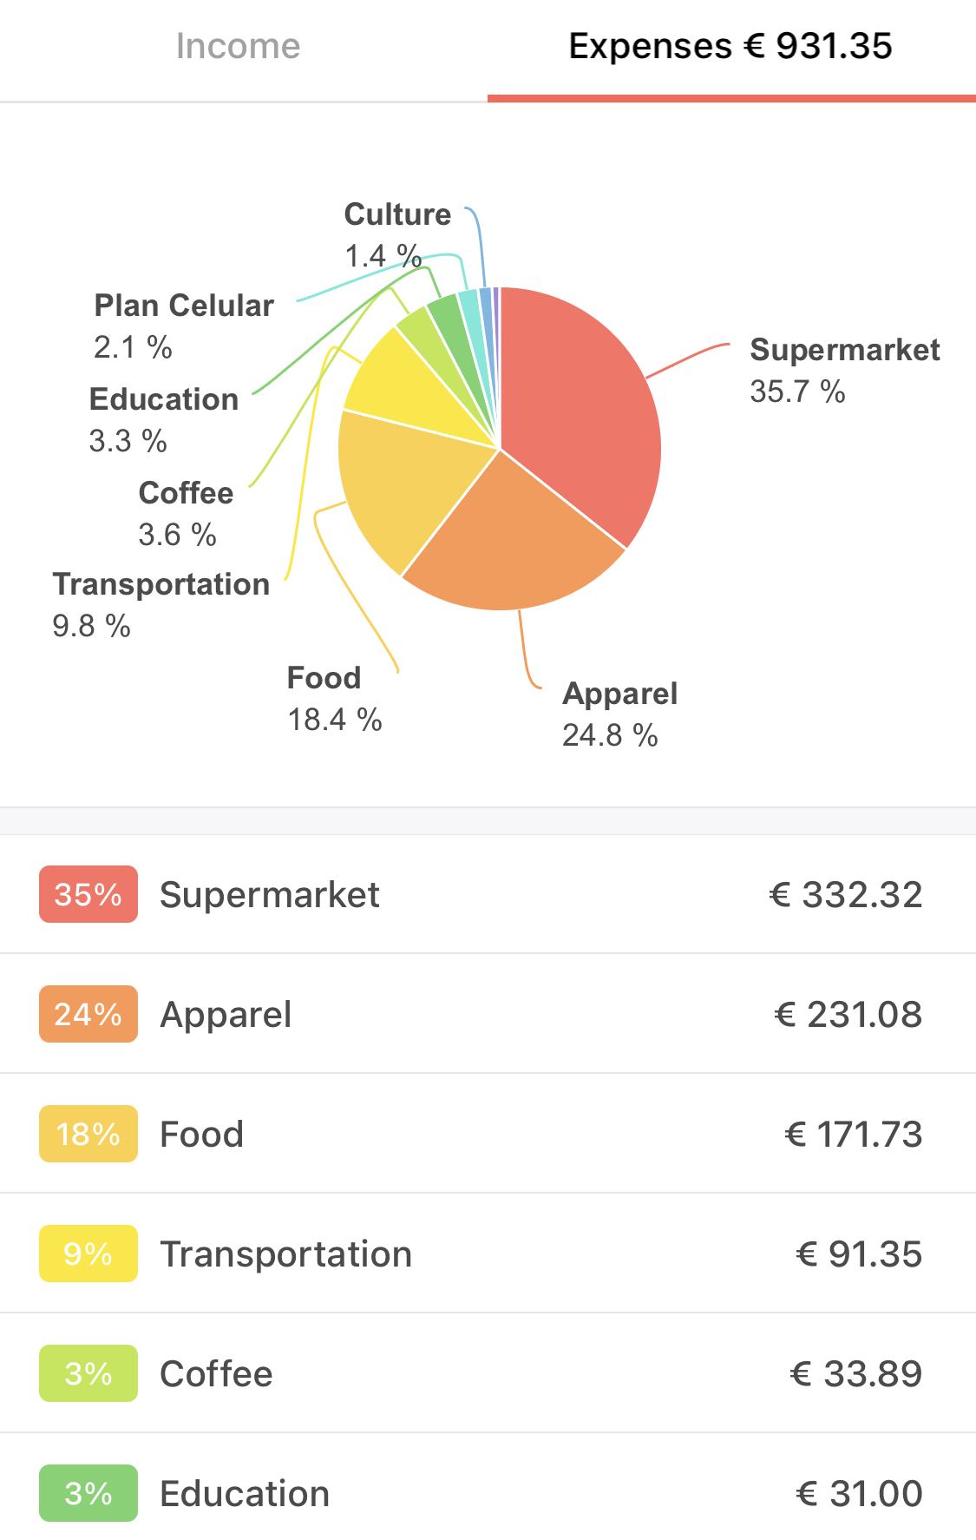
Add transaction page
The stats page :
ADD TRANSACTION
Susana
STATS
< MONTH 2021 >
Type:
Date:
Category:
Amount:
Name:
Description:
Save

Slide 3
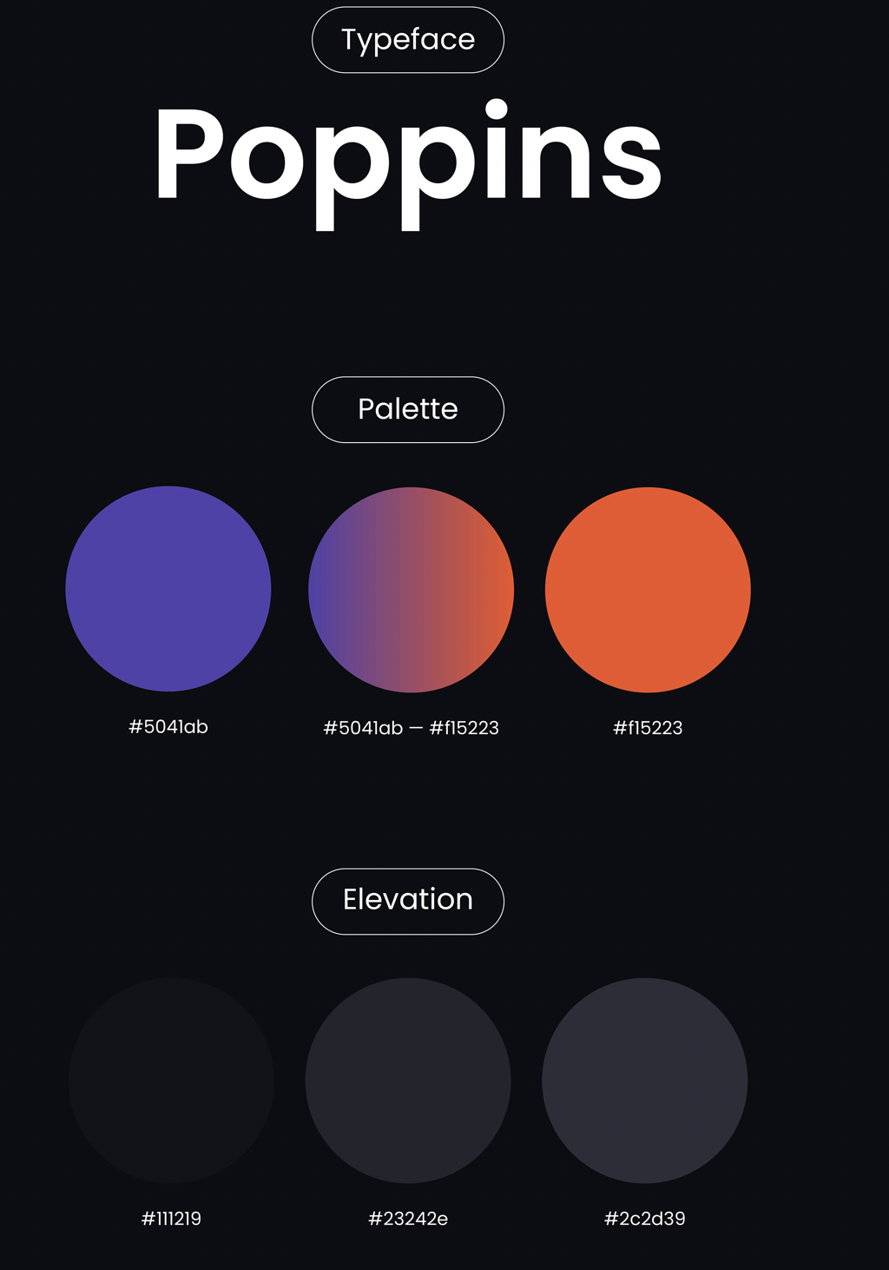
Color Pallete

Slide 4
User Stories
As an user….
I want to add and expense, so that it is stored in the the database.
I want to edit my expenses so that if I made a mistake I can correct it.
I want to categorize each expense so I can then visualize all my expenses by category.
I want to see a summary of my expenses so that I can get an insight on how much I am expending per month.

